Slide 1
Finance Data Access
April 7, 2020
Getting More from Web Intelligence
Conference Sponsors: The Office of the Chancellor, Budget and Financial Administration / Human Resources, the Office of the Provost and Vice Chancellor for Academic Affairs, the Office of the Vice Chancellor for Research, and the Office of the Chief Financial Officer

Slide 2
Presenter
Jerry Myers, AITS
  jdmyers6@uillinois.edu

Slide 3
Agenda
Getting/Granting Finance Data Access
Report/Tool availability
Troubleshooting

Slide 4
Finance Access
Access to Financial Data in the warehouse is straight forward
…well, that was the intent

Slide 5
Finance Access
Access is controlled by
  AITS Security Application https://www.aits.uillinois.edu/access/usc_website/
  DS USC Application https://appserv7.admin.uillinois.edu/dsuscapp
  Access Manager (My-UI-Financials) https://myuifinancials.uillinois.edu/myFi/

Slide 6
Finance Access Levels
There are two basic levels for Finance
  Finance Report Refresher
    Often referred to as Standard Report access
  Finance Power User
Do either limit the user’s access to data?
  Technically, no. All finance data is open to each role, the roles limit how EDDIE/Web Intelligence interacts with the data

Slide 7
Finance Access Levels
Does Finance Power User include Standard Reports?
  No, the two roles are independent of each other.
Can both roles be include in one request?
  No, the access is controlled by two different apps/processes

Slide 8
Finance Report Refresher
This role gives the user access to these reports in the EDDIE Finance folder
FIAP_Bank_Activity_Detail; FIAP_Detail_by_FOAP; FIAR_ATBE_By_Account; FIAR_ATBE_By_Detail_Code; FIAR_Account_Detail_By_Detail_Category_Code; FIAR_Account_Detail_By_Detail_Code; FIAR_Aging_By_Detail_Code_Summary; FIAR_Aging_Single_Line_By_Account; FIAR_Aging_by_Account; FIAR_Open_Invoice_By_Account; FIAR_Open_Invoice_By_Detail_Category_Code; FIAR_Open_Invoice_By_Detail_Code; FIBUD_Budget_Memo_Log; FIFX_Monthly_Activity_by_Chart_and_Organization; FIGL_Account_Index_Report; FIGL_Asset_Liability_Statements; FIGL_Asset_Liability_Transactions; FIGL_College_Dept_Fund_Type_Summary; FIGL_College_Dept_Fund_Type_Summary_ITD; FIGL_Fund_Hierarchy; FIGL_Fund_Type_Summary; FIGL_General_Ledger_Dept_Fund_Summary; FIGL_General_Ledger_Fund_Summary; FIGL_General_Ledger_by_Account; FIGL_Location_Hierarchy; FIGL_Operating_Ledger_Summary; FIGL_Operating_Ledger_Summary_ITD; FIGL_Operating_Statement_College_Rollup; FIGL_Operating_Statement_College_Rollup_ITD; FIGL_Operating_Statement_Rollup; FIGL_Operating_Statement_Rollup_ITD; FIGL_Organization_Hierarchy; FIGL_Program_Hierarchy; FIGL_Restricted_Funds_Balances_by_Account_Type; FIGL_Restricted_Funds_Balances_by_Fund_Type; FIGR_Grant_Detail; FIGR_Grants_Status_and_Billing_Summary_Report; FIGR_Multifund_Management_Report; FIOL_Encumbrance_Balances; FIOL_Misclassified_FOAPAL; FIOL_Revenue_Expense_Statements; FIOL_Revenue_Expense_Statements_Inception_to_Date; FIOL_Revenue_Expense_Transactions; FIOL_Revenue_Expense_YTD_Transaction_Statement; FIOL_Revenue_Expense_YTD_Transaction_Statement_by_Account; FIOL_Revenue_Expense_YTD_Transaction_Statement_by_Account_and_Period; FIOL_Revenue_Expense_YTD_Transaction_Statement_by_Acct_by_Period_Range; FIPO_Departmental_Requisition; FIPR_Payroll_Expense_by_Person_Month_End; HPAY_Payroll_Encumbrance_by_Person_MYE_Year_End; HPAY_Payroll_Encumbrance_by_Person_Month_End; UIC_SponsoredProjectExpenditures; UR_FIAR_FIN_Ledgers_AR_Payment_Trans; UR_FIFA_Commodity_Search; UR_FIFA_FIXED_ASSET_Pending_List; UR_FIFA_Fixed_Asset_By_Org; UR_FIGL_College_MultiFund_Management_Report; UR_FIGL_Departmental_MultiFund_Management_Report; UR_FIGL_LOCATION; UR_FIGL_Operating_Ledger_By_Org; UR_FIGR_GRANT_DETAIL; University Revenue and Expense Dashboard

Slide 9
Finance Power User
This role gives the user access to these reports in the EDDIE
  NONE
  The Power User role allows you to see any report that was created using Finance Universes outside the Finance Folder, including those in Solution Library – Money
  Another way to consider it is, Finance Report Refresher limits what you can see while Finance Power User allows to see all other finance-related reports
  Finance Power User allows you ability to edit or create reports

Slide 10
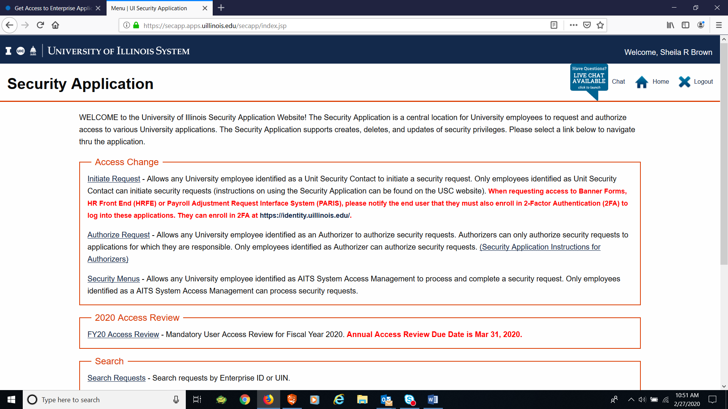
Getting the Finance Report Refresher Role (USC instructions)
Log into the AITS Sec App

Slide 11
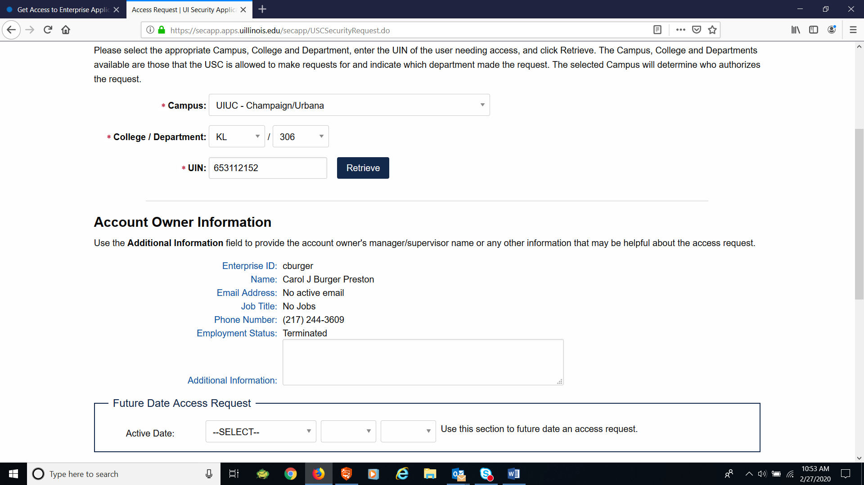
Getting the Finance Report Refresher Role (USC instructions)
Enter the UIN of the account owner (the person needing access)

Slide 12
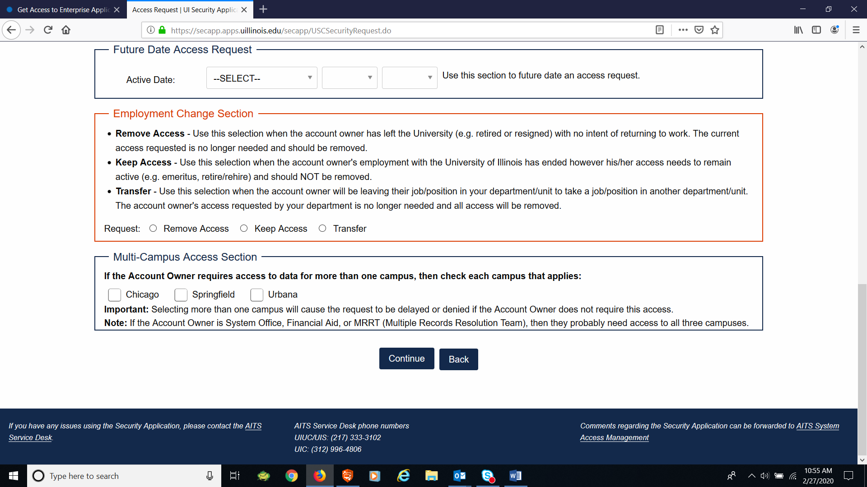
Getting the Finance Report Refresher Role (USC instructions)
Click Continue button

Slide 13
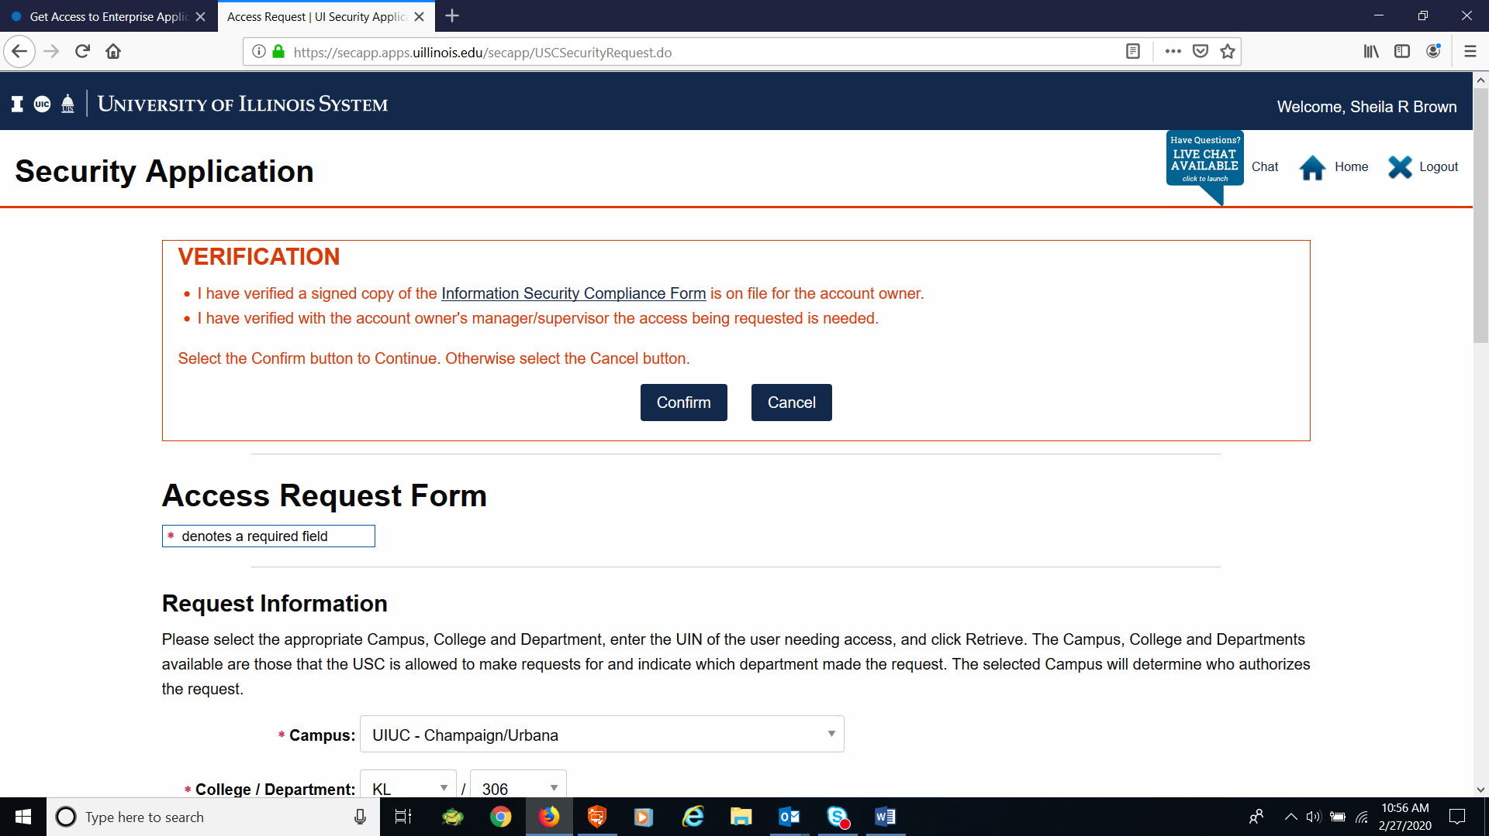
Getting the Finance Report Refresher Role (USC instructions)
Click Confirm button

Slide 14
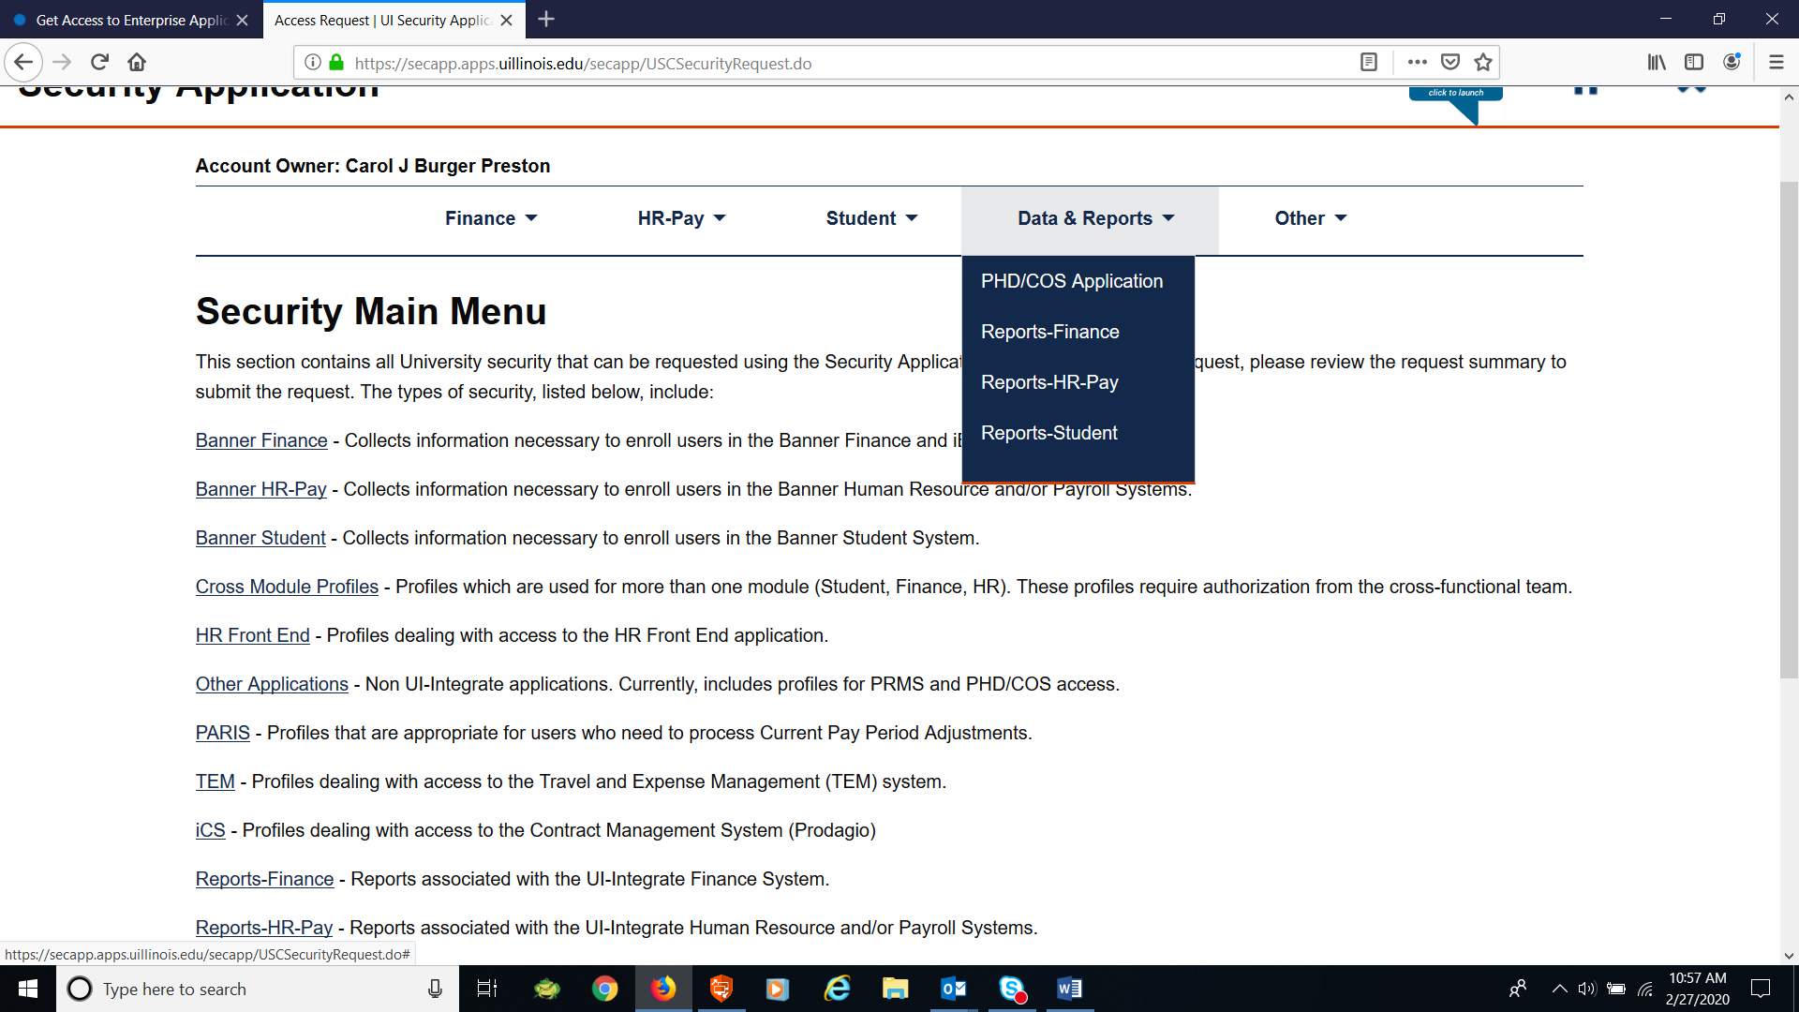
Getting the Finance Report Refresher Role (USC instructions)
Under Data & Reports, select Reports-Finance from the drop down menu

Slide 15
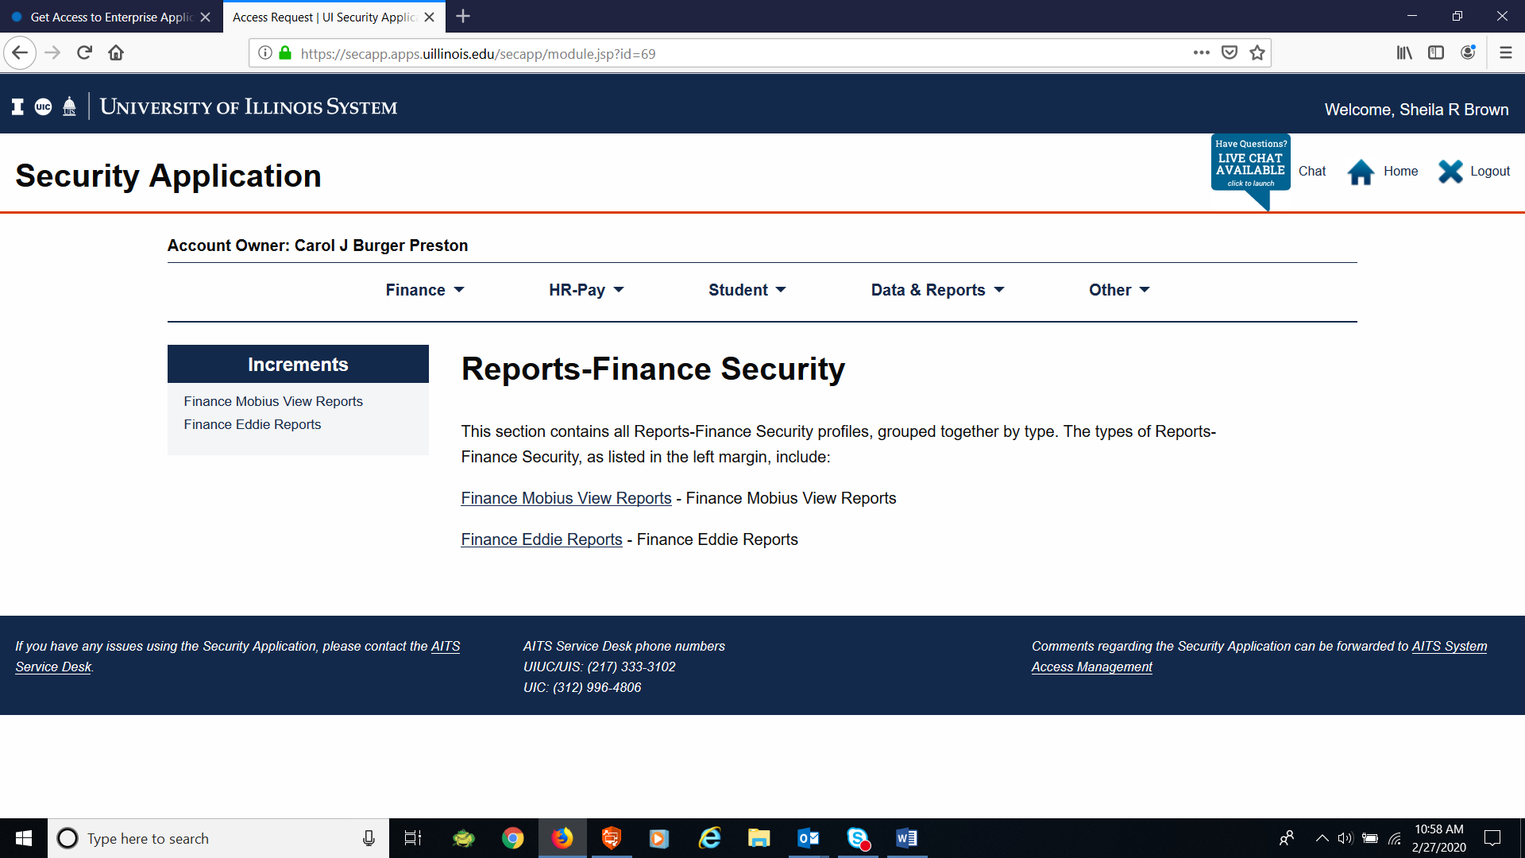
Getting the Finance Report Refresher Role (USC instructions)
Select Finance Eddie Reports

Slide 16
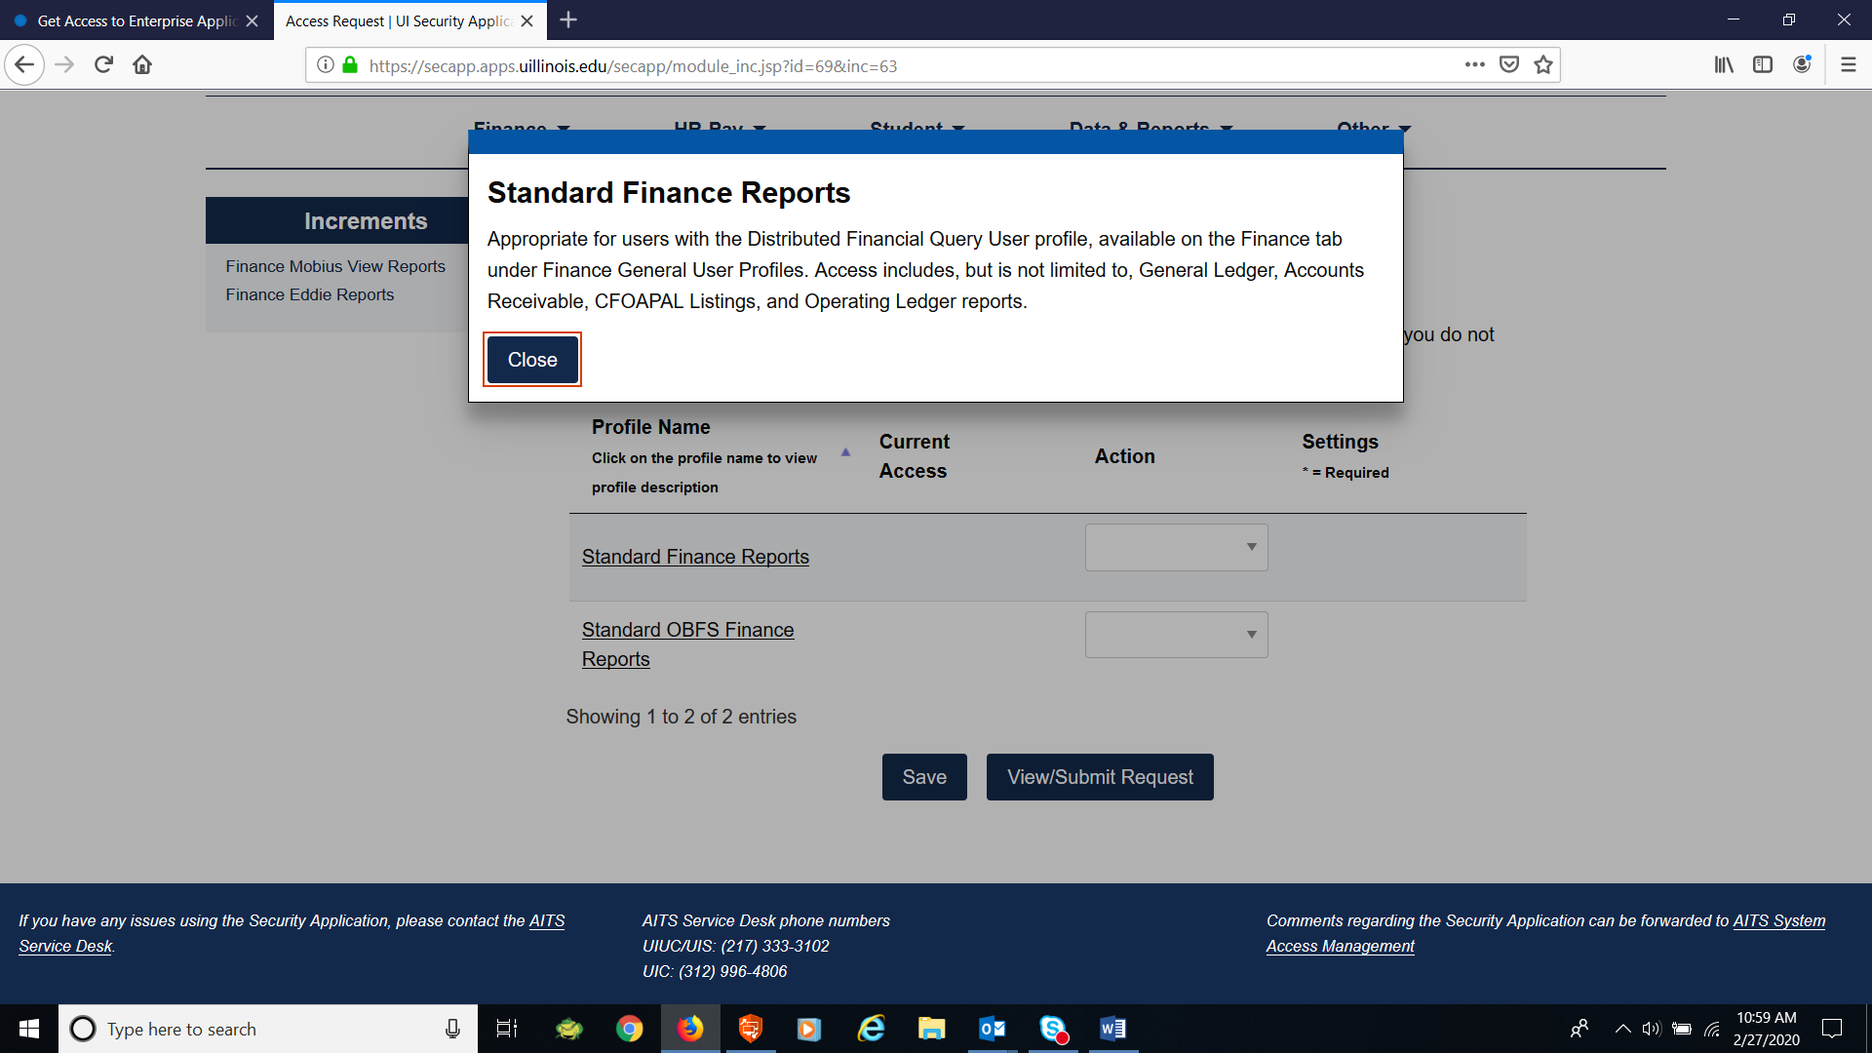
Getting the Finance Report Refresher Role (USC instructions)
Double clicking on Standard Finance Reports will bring a pop up box with a description of what the access providers to the user

Slide 17
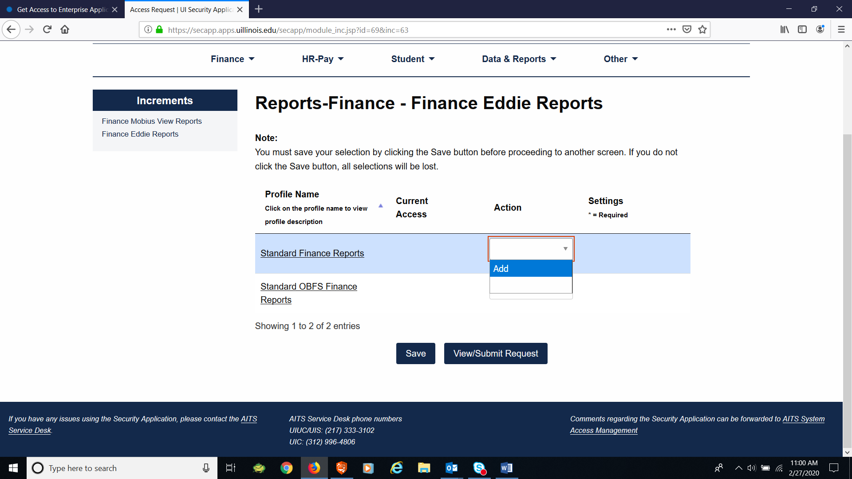
Getting the Finance Report Refresher Role (USC instructions)
The Action field is a drop down to either add/delete the access
Click Add and then the Save buttons

Slide 18
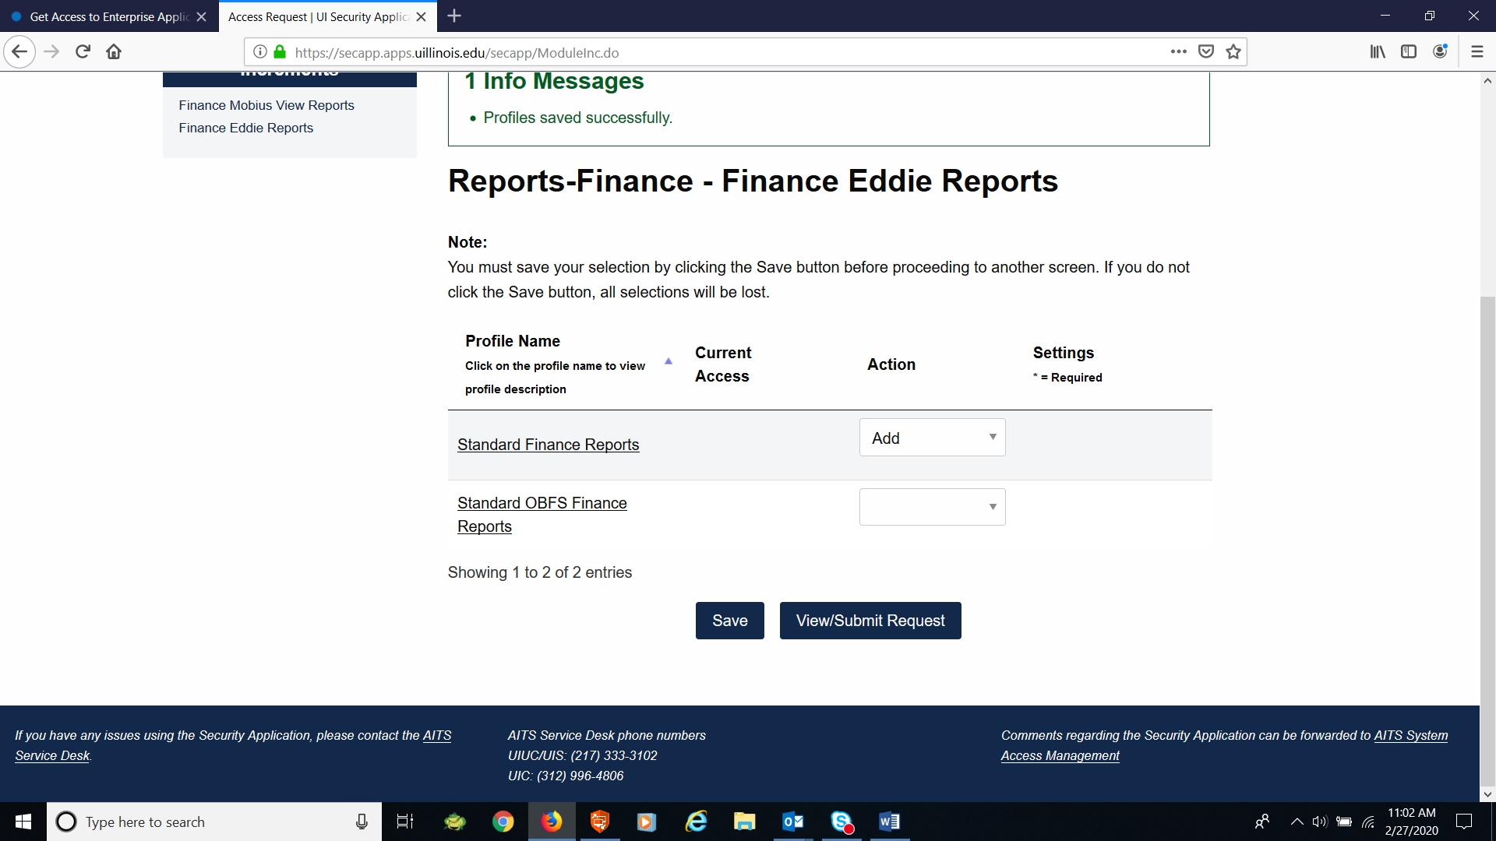
Getting the Finance Report Refresher Role (USC instructions)
The USC will receive message box that the profile has been saved successfully
The USC can then either continue to request additional access, or if nothing else is needed, click the View/Submit Request button and continue to submit the request

Slide 19
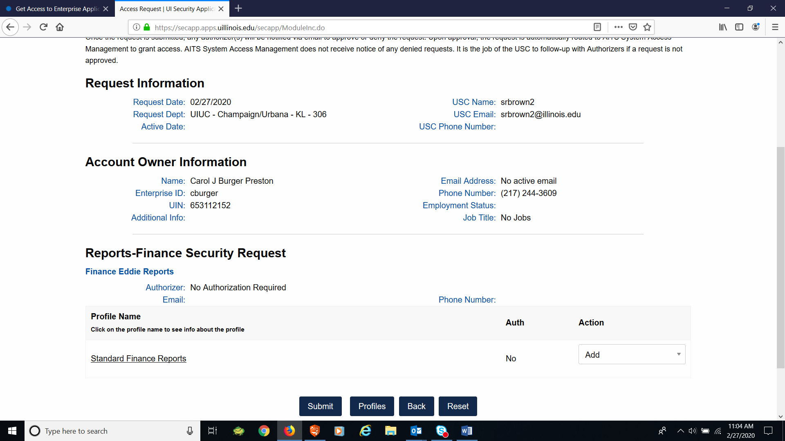
Getting the Finance Report Refresher Role (USC instructions)
Clicking the Submit button will complete the request and it will go to the processing queue to be processed at the next processing time

Slide 20
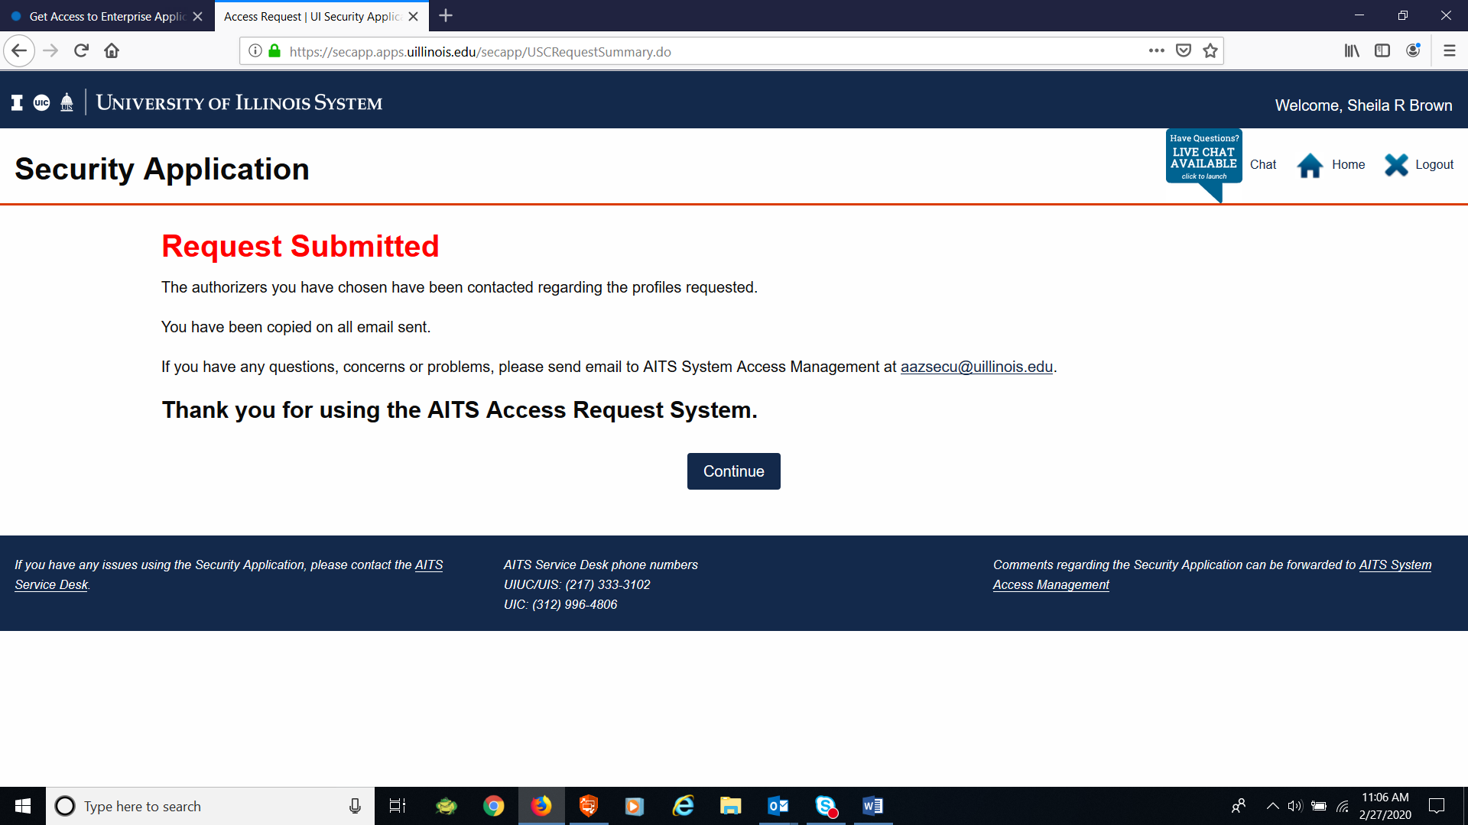
Getting the Finance Report Refresher Role (USC instructions)
Access and the ability to log in by the user should be complete overnight

Slide 21
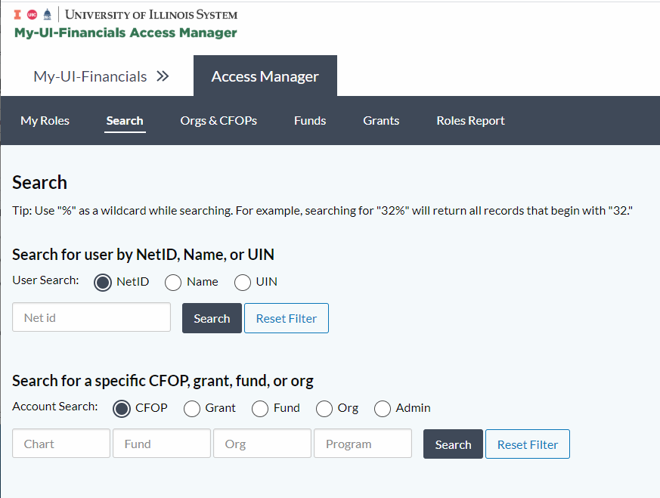
Getting the Finance Report Refresher Role (Access Manager)
If a user has not been previous set up in EDDIE, an entry in Access Manager will automatically grant them the Finance Report Refresher role
This does not need to be completed by a USC

Slide 22
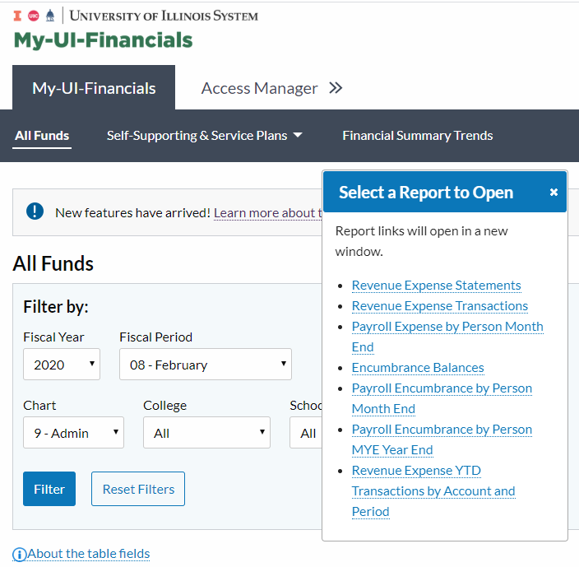
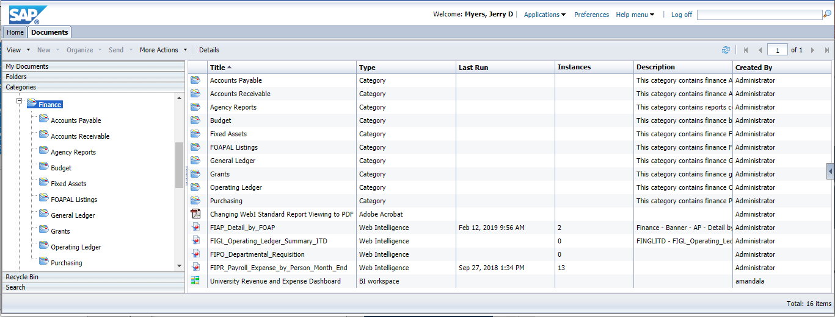
Finance Report Refresher Role (User Access)
The user will now be able to log into EDDIE and run reports in the Finance folder as well as access the reports in My-UI-Financials.

Slide 23
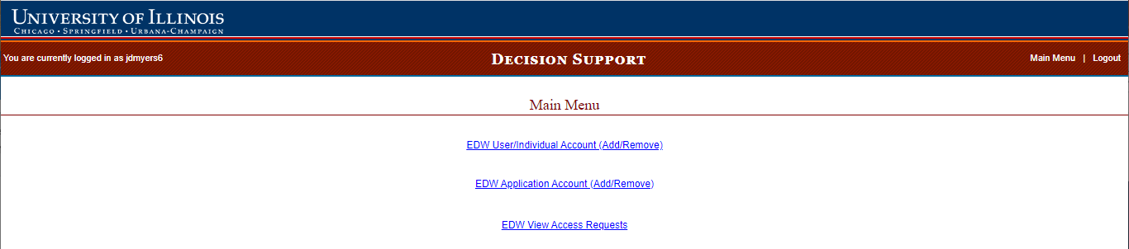
Getting the Finance Power User Role (USC)
Select the top choice
EDW User/Individual
Account (Add/Remove)

Slide 24
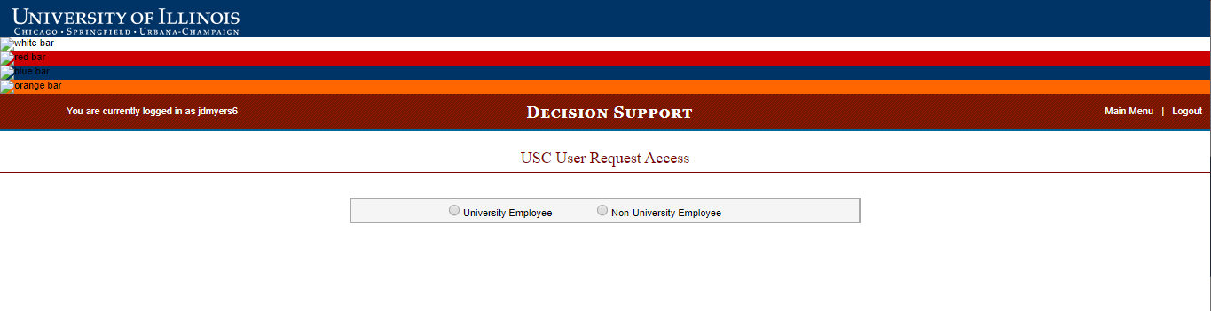
Getting the Finance Power User Role (USC)
Select University Employee

Slide 25
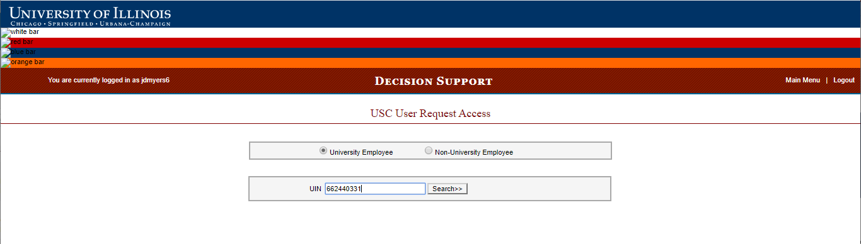
Getting the Finance Power User Role (USC)
Enter UIN of the person you
Wish to grant access

Slide 26
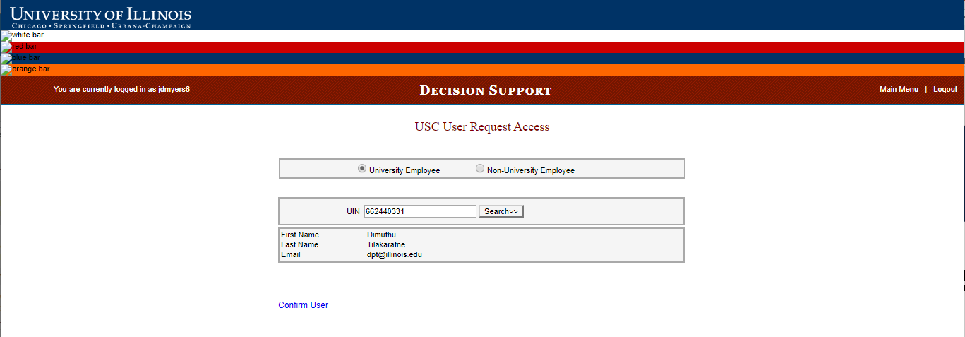
Getting the Finance Power User Role (USC)
Enter UIN of the person you
Wish to grant access and
Click Search

Slide 27
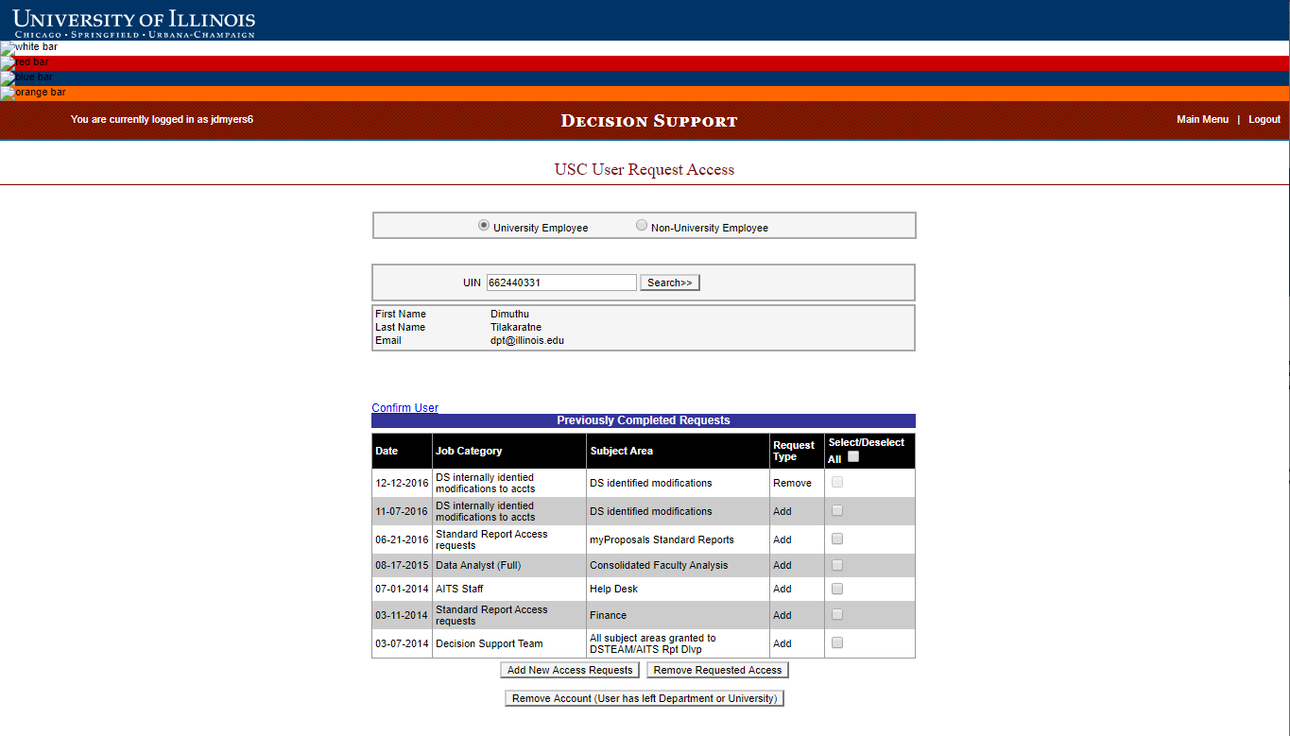
Getting the Finance Power User Role (USC)
Click Confirm User

Slide 28
Getting the Finance Power User Role (USC)
Click Add New Access Requests

Slide 29
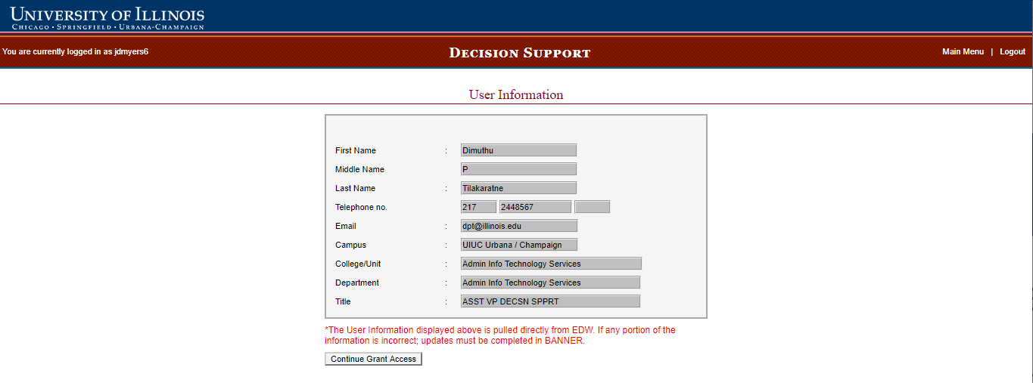
Getting the Finance Power User Role (USC)
Click Continue Grant Access

Slide 30
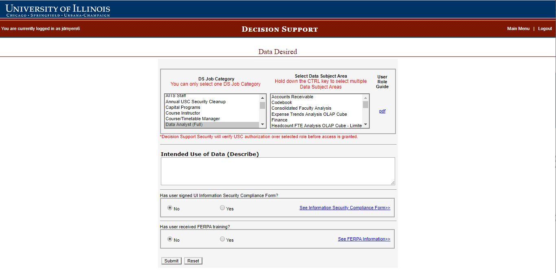
Getting the Finance Power User Role (USC)
Select an appropriate DS Job Category:

Slide 31
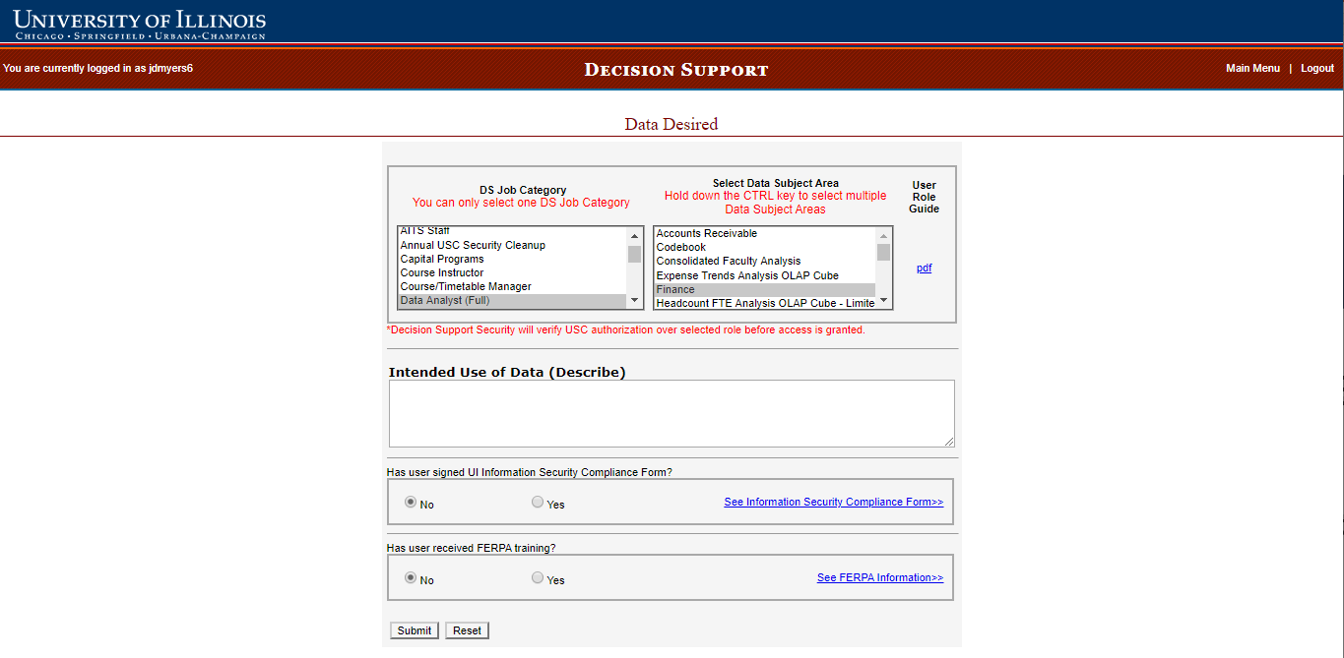
Getting the Finance Power User Role (USC)
Select an appropriate DS Job Category:
Enterprise-wide Auditor CITES/ACCC
Data Analyst (Full)
Data Analyst (Limited)
Executive Officer Financial Aid Manager
Finance Manager OVCR - Grants Office
OBFS Staff Personnel Manager
Then Select Data Subject Area
Finance
Then click Submit

Slide 32
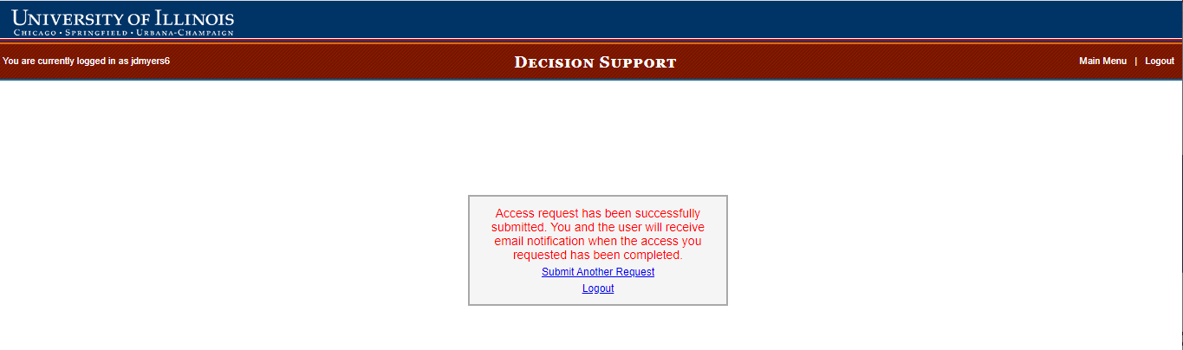
Getting the Finance Power User Role (USC)
Access and the ability to log in by the user should be complete overnight

Slide 33
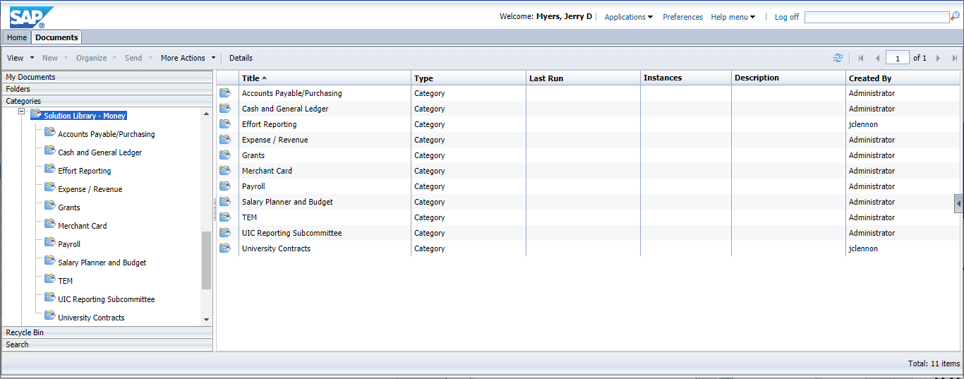
Finance Power User Role (User Access)
The user will now be able to log into EDDIE and run reports in the Solution Library - Money folder, be able to modify existing reports, create reports and download Rich Client if desired.

Slide 34
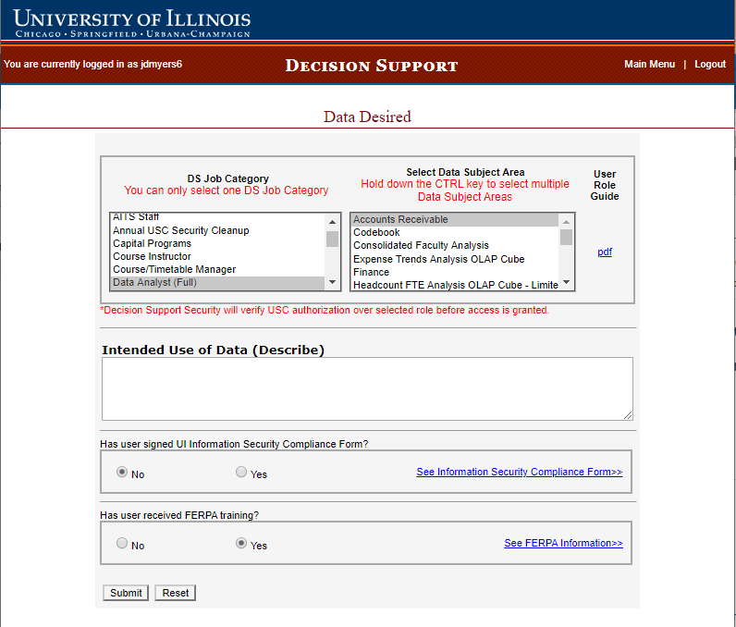
Additional Finance Users Role (Accounts Receivables)
Finance AR Power Users is available in DS Job Categories:
Enterprise-wide Auditor
Data Analyst (Full)
Financial Aid Manager
OVCR - Grants Office
OBFS Staff
The Select Data Subject Area is Accounts Receivable and the USC must indicate the user has had FERPA training

Slide 35
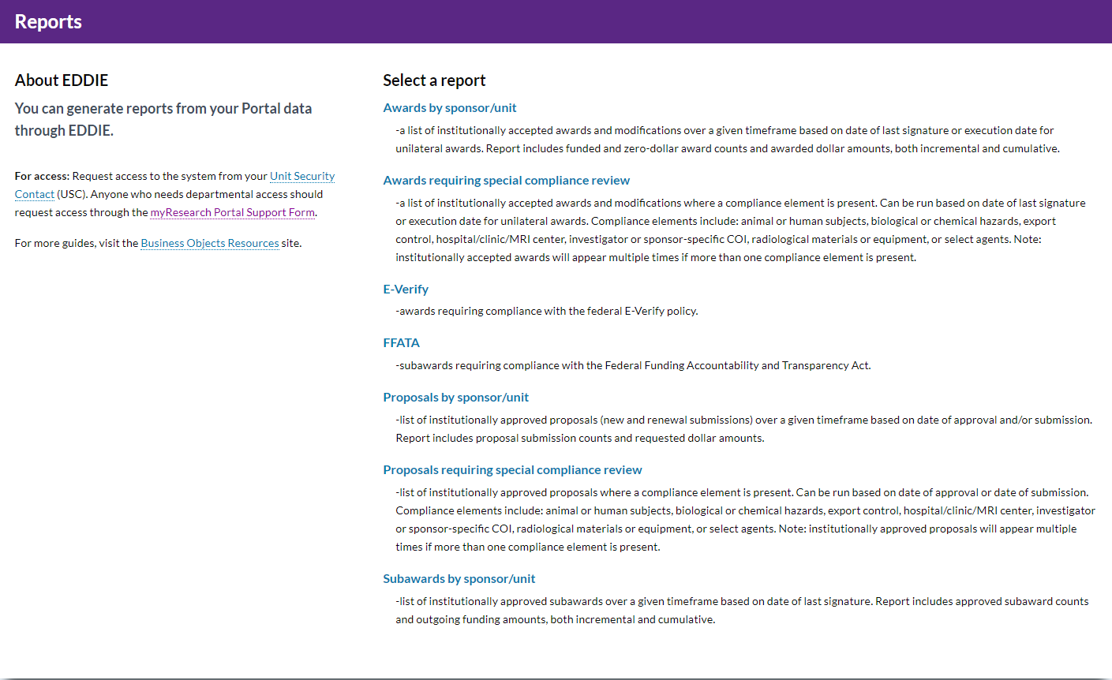
Additional Finance Users Role (Kuali Coeus)
Proposals data was once included with the Finance roles, but no longer.
myProposals Report Refreshers access live data. Departmental Access is requested by the USC via the support form: https://appserv7.admin.uillinois.edu/FormBuilderSurvey/Survey/AITS/START_myResearch/myResearch_Portal_Support_Form/Survey

Slide 36
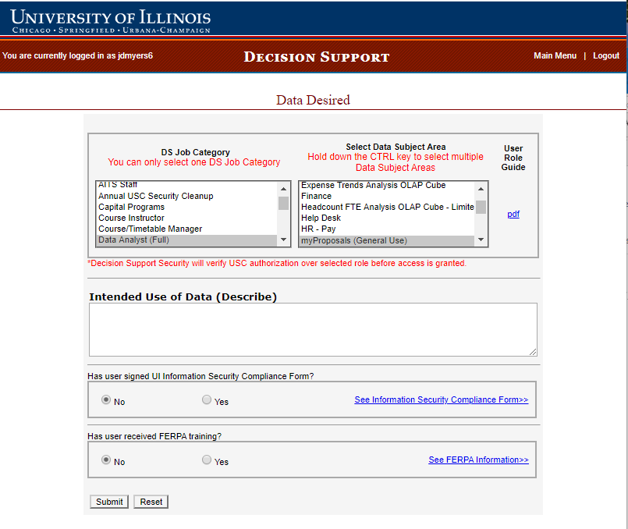
Additional Finance Users Role (Kuali Coeus)
Additional reports are available in Solution Library – Money which are written from data warehouse tables. Users can also create their own reports from this data. Access is requested in the DS USC App in the Data Subject Area myProposals (General Use). This data is not secured to the department level and includes access to all three Universities.

Slide 37
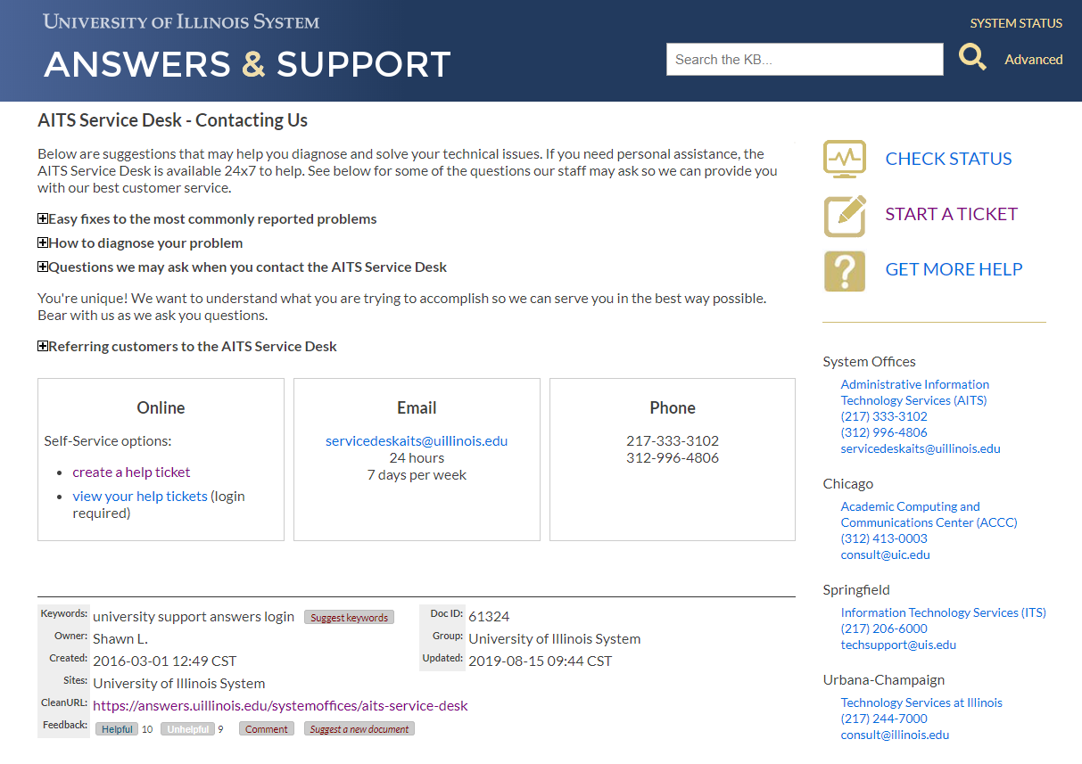
Troubleshooting
If you have an issue, please refer to: https://answers.uillinois.edu/systemoffices/aits-service-desk where you can submit a ticket.
Possible issues:
Human error – it is a manual process
User inactivity – access removed after two years of system inactivity
Changing departments – previous USC removing access after current USC request
User log-in error
Temporary system issues

