Slide 1
Travel and expense reporting & Non-po Invoice
Training on new universes

Slide 2
Travel and Expense Reporting Universe
Requires Finance Power User access
Sources Chrome River data
Includes Banner CFOAPAL hierarchy at the Allocation level
Not all elements from Chrome River are currently available
All data in the universe is available to all users
Data represents previous days activity
Travel and Expense Reporting.unx (Chrome River) NOT EDW – Finance Travel and Expense (TEM)

Slide 3
Non-PO Invoice Universe
Requires Finance Power User access
Sources Chrome River data
Includes Banner CFOAPAL hierarchy at the Invoice Voucher Line
Not all elements from Chrome River are currently available
All data in the universe is available to all users
Data represents previous days activity
Represents Non-PO Invoices and One-Time Vendors

Slide 4
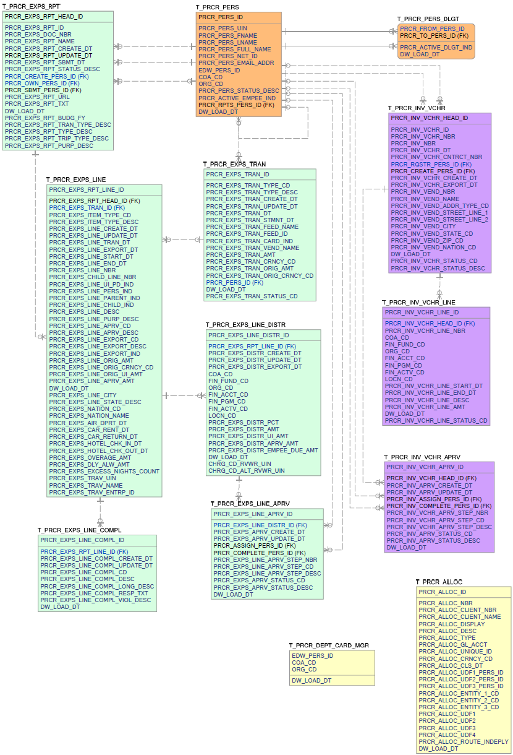
Procurement data Model

Slide 5
Travel and Expense Reporting Universe
Organized in views to eliminate issues due to context
  Approvals
  Compliance
  Delegation
  Unattached
  Charge Code Reviewers (pending)
Several instances exist that can cause inaccurate dollar amounts
Check against the source when building reports
Uses the Procurement Data Model

Slide 6
Travel and expense reporting Universe design
The universe is designed very similar to the data table layout
  Approvals includes Expense Report, Expense Line, Expense Transactions attached to Expense Lines, Allocation, and Banner CFOAPAL hierarchy
  Compliance includes Expense Report, Expense Line and Compliance
  Delegations includes Person and Delegate
  Unattached includes Transactions not attached to Expense Lines
  Charge Code Reviewers will contain data by CFOP

Slide 7
Joins that can create multiple values
The Expense Header can have multiple Line Items
Line Items can have a parent record with multiple child records
Each Line Item has a Transaction record with Vendor Name
Each Line Item can have multiple Allocations
Each Allocation can have multiple Approval Steps
CFOAPAL is tied to the Allocation level

Slide 8
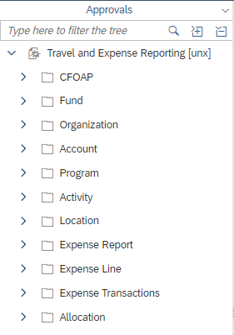
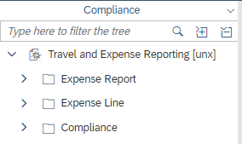
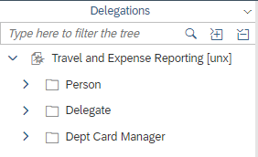
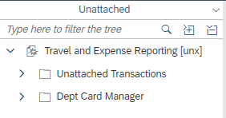
tRavel and Expense Reporting Universe design

Slide 9
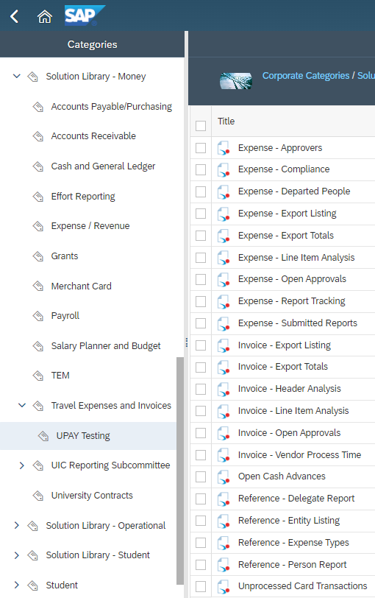
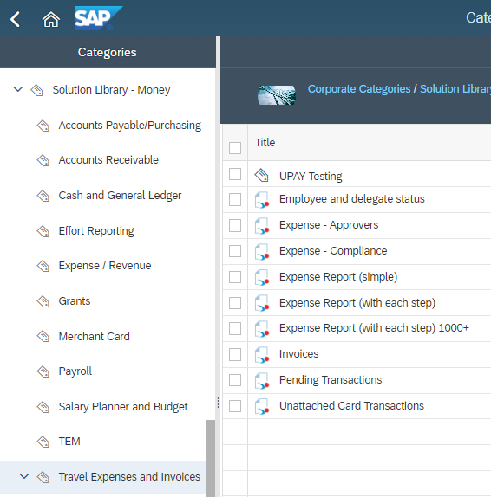
Report examples

Slide 10
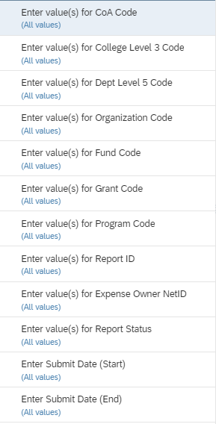
Report example – Expense report

Slide 11
Report example – Expense report
This report pulls every field available in the universe and displays the data on separate tabs (Allocations, Compliance, and Delegations)
The first tab, Expense Report displays data elements as they may appear in Chrome River on an Expense Report.
The base of the report is using Allocations with Compliance elements added.

Slide 12
Report example – Expense report
Compliance data is pulled by passing the Report ID from the first query.
Delegaton data is pulled by passing the Expense Owner UIN from the first query.
If either results in more than 1,000 records being passed, the report will produce an error.
Limit the criteria in the prompts to avoid this.

Slide 13
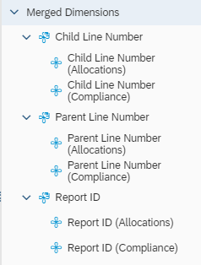
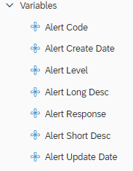
Report example – Expense report
Report ID, Parent and Child Line Numbers need to be merged.
          Variables can then be created
          to bring in Compliance elements

Slide 14
Report example – Expense report
Variables are worth noting.
  Header Line AMT and Line AMT are created from the Allocation table down to the CFOAPAL to eliminate duplication.
  Max Approval Step is incorporated in the Line AMT so as not to duplicate the amount for each step.

Slide 15
Variable defenitions
Banner Rule Class Code
  =If([Transaction Card Indicator]<>"Y";"INN"+If([Allocation Amount]<0;"C";"I");If([Transaction Feed]="MC Procurement Card";"P";"V")+If([Allocation Amount]<0;"C";"I")+If(Left([Fund Type Level 2 Code];1)="1";"S";"L"))
Header Line AMT
  =[Allocation Amount] Where ([Parent Line Indicator] = "Y") In ([Report ID];[Parent Line Number];[Child Line Number];[CFOAP];[Activity Code];[Location Code])Banner Rule Class Code

Slide 16
Variable defenitions
Line AMT
  =[Allocation Amount] Where ([Parent Line Indicator] = "N" And [Approval Step Order] = [Max Approval Step]) In ([Report ID];[Parent Line Number];[Child Line Number];[CFOAP];[Activity Code];[Location Code])
Max Approval Step
  =Max([Approval Step Order]) In ([Allocations].[Report ID];[Allocations].[Parent Line Number];[Allocations].[Child Line Number])

Slide 17
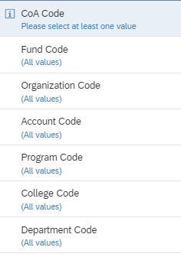
Report example – pending Transactions

Slide 18
Report example – Pending Transactions
Lists transaction based upon Approval Status and CFOAP prompts
  Includes link to Chrome River Expense Report. For the link to work, the user needs to be logged into Chrome River and have rights to view
  Includes Report ID and Expense Owner along with other detail
  Does not include any element outside the Approvals view

Slide 19
Report example – Pending Transactions
This report pulls from the Allocations view.
The report can be run for any approval status but is designed to run for Pending (PEND) transactions.

Slide 20
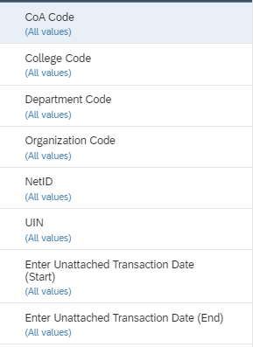
Report example – unattached card transactions

Slide 21
Report example – unattached card transactions
This report pulls from the Unattached view.
The report is run to determine card transactions that have not been attached to an expense line in Chrome River.

Slide 22
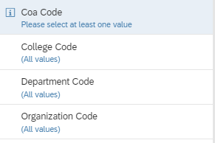
Report example – Employee and Delegate status

Slide 23
Report example – Employee and delegate status
This report pulls from the Delegations view.
The report is run to determine the status of all employees and delegate assignments within Chrome River.

Slide 24
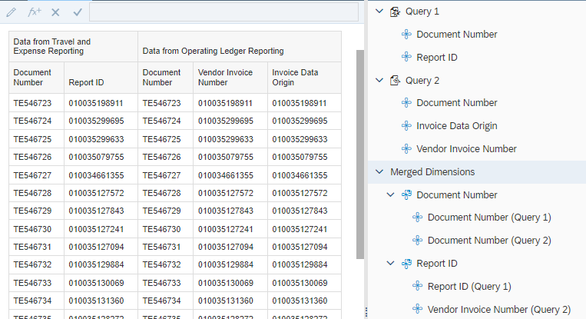
Joining to banner data
Document Number (TE######)
Report ID (0100########) will join to Vendor Invoice Number or Invoice Data Origin
Attempting to join down to the line level is not possible.
Data can differ between to two systems. For example, a journal voucher processed in Banner will not be reflected in Chrome River.

Slide 25
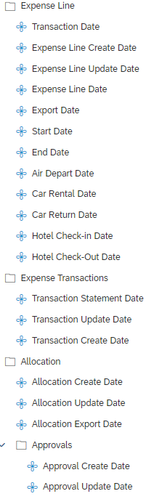
Notes & Report examples
Fiscal Year and Period prompts are not available as there are 20+ different date fields.
Amounts can be in foreign denominations

Slide 26
Non-Po Invoice Universe
Only one view
Several instances exist that can cause inaccurate dollar amounts
  Approvals are at the header level
  CFOAPAL data ties to the line level
Check against the source when building reports
Uses the Procurement Data Model

Slide 27
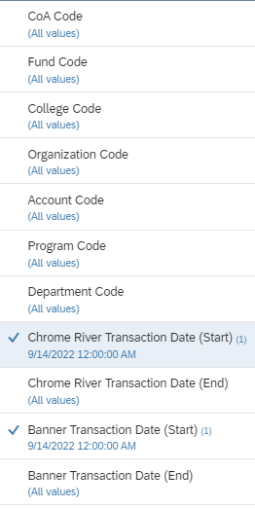
Report example – invoices

Slide 28
Report example – invoices
This report pulls every field available in the universe and displays the data on five tabs
Banner data via the Operating Ledger Reporting is also displayed
The first tab represent Non-PO Invoices, the second One-Time Vendors
The other three tabs are to show data available
This report was created before Invoice Data Origin was available in Operating Ledger Reporting.

Slide 29
Report example – invoices
Banner data via the Operating Ledger Reporting is also displayed
The first tab represent Non-PO Invoices, the second One-Time Vendors
The other three tabs are to show data sources
A Non-PO invoice will be reflected in Banner as a Document Number TE% and Invoice Data Origin 0500%
A One-Time Vendor will be reflected in Banner as User Name 9OBFSCR% and Invoice Data Origin 0500%

Slide 30
Report example – invoices
Matching on Invoice Number is also possible noting Chrome River and Banner format them differently.
  Non-PO Inv No formatted =Left(Upper([Invoice Number]);15)
  One-Time Inv No formatted =Upper([Invoice Number])
Merging on CFOAPAL can increase chances of matching to the line level.

Slide 31
Report example – UPAY Testing
These report are being created to replicate the Standard Reports currently available in Chrome River.
Chrome River will discontinue the reports within the system.
Please report any issues and desired enhancements.
New reports data elements will be added working with UPAY, UAFR, SOSS, and more.

Slide 32
Resources
OBFS – Chrome River
  https://www.obfs.uillinois.edu/travel-resources
AITS Resources
  AITS - Reports & Data
  EDDIE and Web Intelligence Rich Client Resources
  Contact AITS
  jdmyers6@uillinois.edu

