Slide 1
ITPC-05XX Design standards
Kick-off Meeting
October 1, 2017

Slide 2
Agenda
The project kickoff meeting is the official start of the project and the full engagement of the project team. In addition, the kickoff meeting sets the stage for planning tasks. The desired outcome for this meeting is an approved project charter.
Agenda | Time
Overview, justification, and scope | 5 min
Team and roles | 10 min
Project processes | 5 min
Draft of high level schedule | 15 min
Change and scope management (if not covered in roles section above) | 5 min
Impacts, dependencies, and assumptions | 5 min
Risks | 10 min
Next steps | 5 min

Slide 3
Overview
This project will develop standards and guides for the user interface and architectural design of ITPC governed projects.

Slide 4
Why do this?
User interface standards will help ensure intuitive applications with a common University look and feel. Consistent architectures across internally developed systems will create efficiencies through the reuse of technologies, techniques and the staff knowledge set.
Expected benefits: Improve faculty and students’ experiences with internally developed systems | Create IT labor efficiencies and reduce rework by implementing architecture standards | Meet request from UIC IT Governance groups to develop these standards.

Slide 5
In Scope / Out of Scope
In Scope:
  Design document with examples
  Vetted and accepted architecture standards
Out of Scope:
  Creation or conversion of any existing applications or web sites.

Slide 6
Project Team
Sponsor: Marla McKinney
Project manager: Cynthia Cobb
Team members
  QA: Mike Kramer
  Development representative:
  Architecture committee representative:
  Designer:

Slide 7
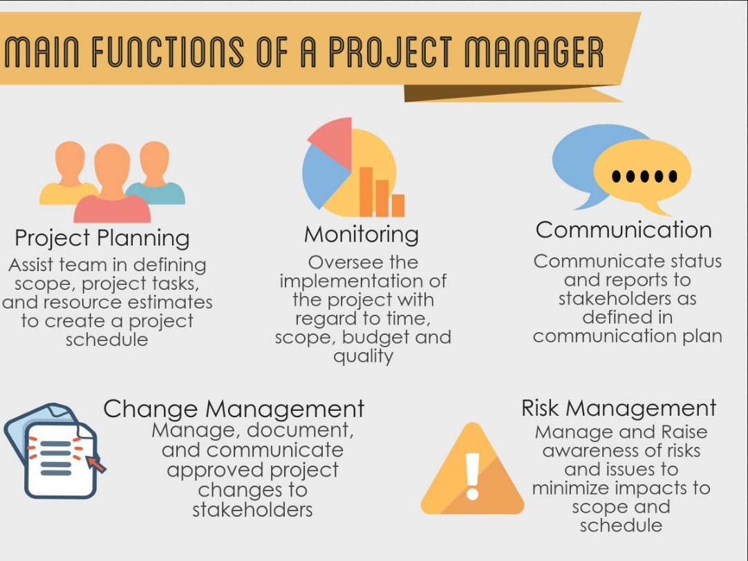
Project manager activities
Planning:
Monitoring:
Communication:
Change management:
Risk management:
Notes:
Planning will be done in 2 planning meetings with the team. Tasks with rough estimates or durations will be developed and I’ll assemble the schedule.
Monitoring—Trello for task status, Monthly status meetings, schedule in Clarity
Communication: Newsletter, status meetings, presentation to UIC ITGC—communication plan to be developed
Change management—requests for significant changes will go through process out lined in the charter.
Risks—couple brainstorming sessions, will assign owners and they will be responsible for monitoring and developing contingency plans

Slide 8
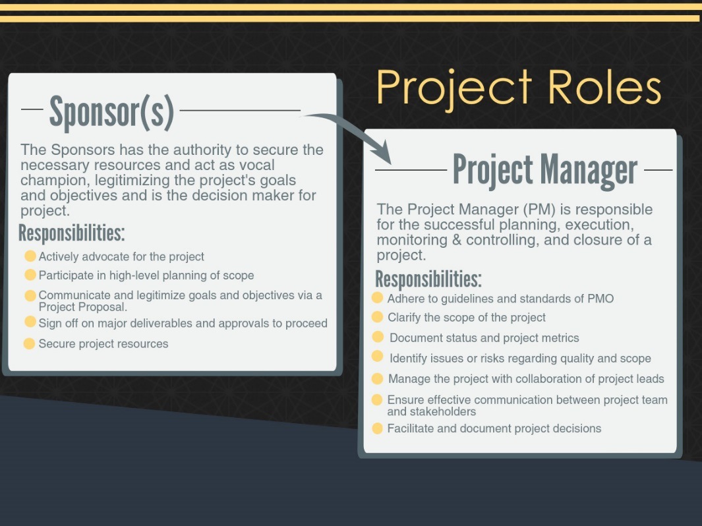
Roles
Sponsor:
Project manager:
Notes:
Our sponsor is Marla McKinney. She will be reviewing our deliverables, helping ensure we have the right team members, and helping us manage our scope.
The project manager roles—is a high level overview of what I already reviewed.

Slide 9
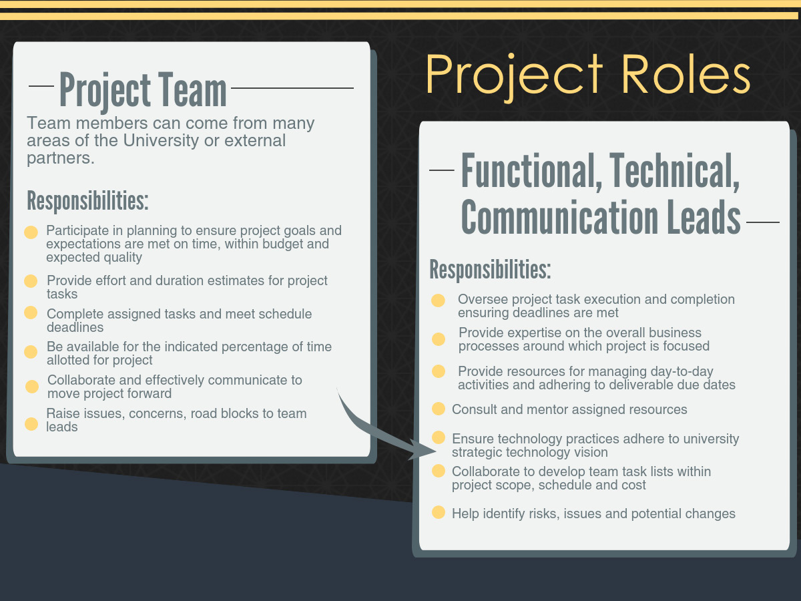
Roles, part 2
Project team responsibilities are
Planning and estimating
Meet deadlines and be available for allocated time
Own risks and issues as assigned
Communicate with the team and the project manager on status of tasks and other items
Lead responsibilities are:
Notes:
This project is small enough that we don’t need a team lead.
(any questions—is everyone comfortable with this)

Slide 10
Team members
Team member and primary role | Responsibility
AJ Lavender, Web Designer | Note—include the following: Responsibility, initial list of deliverables, notes on time commitments

Slide 11
Project Processes
Status meetings
Working sessions as needed, to be initiated and scheduled by team members
Time reporting
Document storage
Change management
Issues/Risks/Decisions
Action items and tasks:
Status reporting
Notes:
Monthly project status meetings
Working Sessions as needed, to be initiated and scheduled by team members
Clarity for time reporting and project schedule
SharePoint for collaboration and documents
Change to scope managed according to standard process
Issues/Risks/Decisions reviewed in status meetings (log included in monthly status report)
Tasks as assigned to team members are managed via Trello
Monthly status report developed and delivered to ITGC

Slide 12
Required standard deliverables
Test plan
Notes:
Include PM deliverables as well.

Slide 13
High-Level schedule and estimated effort
November 2017: Planning and defining deliverables
December 2017: Criteria brainstorming
Team: 4 hours each
January 2018: Document development and review
Traci: 60 hours
February 2018: Rollout and communicate
Traci: 80 hours
Team: 2 hours each
Traci and Steve: 2 hours each to document
Steve: 60 hours
Team: 10 hours each to review
Steve: 24 hours
Team: 20 hours each
Initial draft. This will change after planning.

Slide 14
Change management process

Slide 15
Impacts, dependencies, and assumptions

Slide 16
Initial list of risks

Slide 17
Next steps

